Slide 1




Find The Carrot!!
Akshata Mandloi
Samyak Jain
Pallavi Patil
Date: 06/06/2021

Slide 2



Content
Introduction
Abstract Features
Technology
Implementation
Firebase Database
Learning
Future Scope
Conclusion
References

Slide 3
Introduction
A game is a structured form of play usually undertaken for enjoyment.
Maze game is a mind game where Rabbit finds out the path to reach Carrot through the maze . Maze is a network of paths and edges designed as a puzzle through which one has to find a way. New random Maze generates every time.
Mazes falls under the category of mind games ,as a puzzle game.
Key components of games are goals , rules, challenges and interactions.

Slide 4
Abstract Features
-The Rabbit of the puzzle is designed to move each cell into its respective goal within the fewest number of moves.
-User friendly as we control Rabbit using direction keys.
-Display the moves count after solving the maze.
-This game can be played by a single player at a given time.

Slide 5
Technology
Technologies used in maze game are:-
Html: Used for Creating the User Interface for the Project.
CSS: Provides the Styling to the Interface.
Bootstrap: Provides Styling to the Interface.
JavaScript: Functioning and Backend Support for the Project
Firebase: Provides the Database Support for the Project

Slide 6

Implementation
Index Page

Slide 7
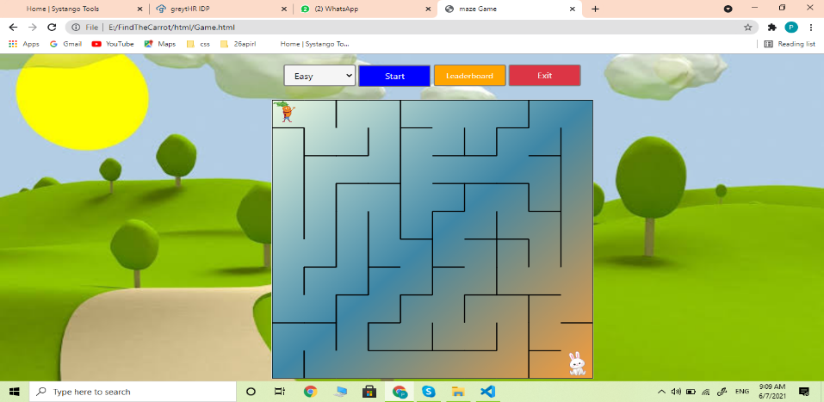

2) Game Window
Easy Level
Medium Level

Slide 8
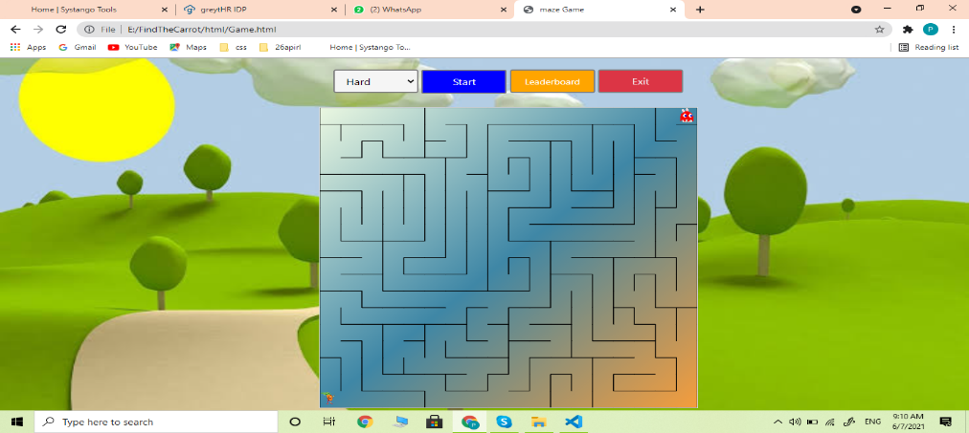

Game Window –Level(Hard)
Hard Level
Extreme Level

Slide 9
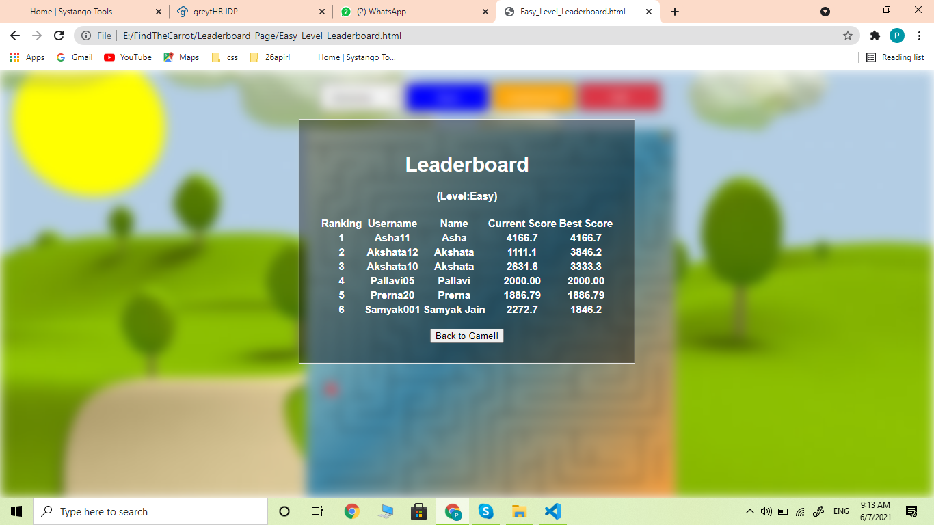
3) Leader Board

Slide 10

Firebase Real-time Database
Firebase is a backend platform for building Web, Android and IOS applications. It offers real time database, different APIs, multiple authentication types and hosting platform.
Real-time Database − Firebase supports JSON data and all users connected to it receive live updates after every change.

Slide 11
Firebase Implementation
Methods Used:
Set :Write or replace data to a defined path, like messages/users/<username>update.
Update: some of the keys for a defined path without replacing all of the data.
Push :Add to a list of data in the database. Every time you push a new node onto a list, your database generates a unique key, like messages/users/<unique-user-id>/<username>.
OrderbyChild : Used to Sort the data base according to the value of Child.

Slide 12
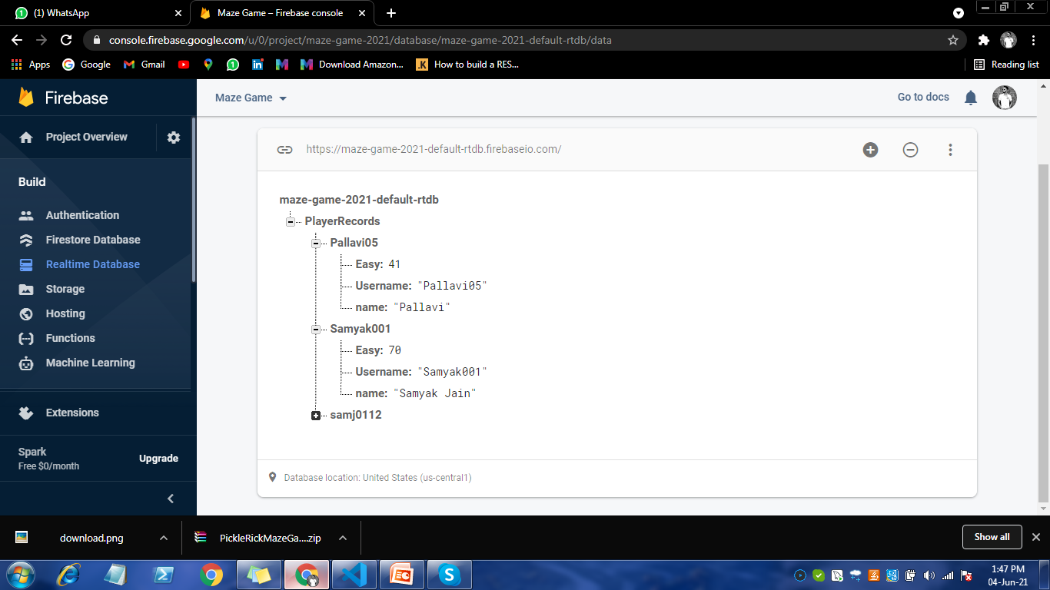
Firebase Implementation

Slide 13
Learnings
Implementation of various HTML and CSS Methods according to different Scenarios.
Working as a Team, How we Coordinate with each other and give our best.
How to Configure and Implement Firebase Database according to Project.
How we approach toward the solution for any Complex Function.

Slide 14
Conclusion
Maze game is basically a mind game where Rabbit has to find a path to reach out Carrot through the maze. Every user must have his/her unique username Id for playing the game . New random maze generated every time on game start. There is a background music for player entertainment.
Finally, scores are shown in the leaderboard according to that specific level using Firebase Realtime Database.

Slide 15
References
https://www.w3schools.com/css/css_dropdowns.asp
http://labs.rampinteractive.co.uk/touchSwipe/docs/%24.fn.swipe.html
https://firebase.google.com/docs/database/web/structure-data
https://google.com
https://www.tutorialspoint.com/firebase/index.htm

Slide 16

Thank You!!!
www.systango.com hello@systango.com
UK: +44 1253 547777

